Slide 1
Capstone Project
Insurance Premium Default Problem

Slide 2
AGENDA
Problem
Quick explain of Problem
Insights Gathering
Insights Gathering from data we have
01
02
Approach
What we Did to find Solution
Difficulties
Regarding Data & Business
03
04
Solution
The best solution we found
Conclusion
Suggestion & Recommendations
05
06

Slide 3
Problem
Allows Start Understanding Problem

Slide 4

Premium paid by the customer is the major revenue source for insurance companies
Default in premium payments results in significant revenue losses
Insurance companies would like to know upfront which type of customers would default premium payments
Who is likely to default?

Slide 5
Insights Gathering
Insights Gathering from data we have

Slide 6

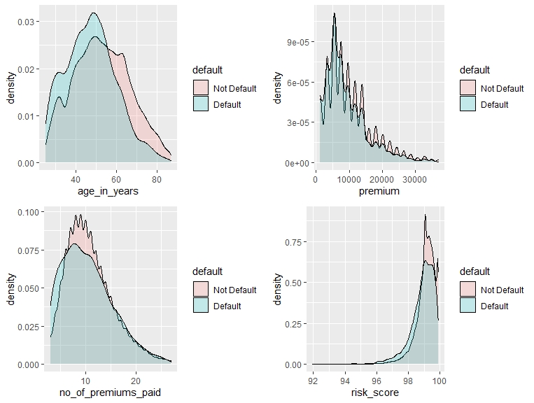
Bivariate Analysis
Default vs Numerical Variables

Slide 7
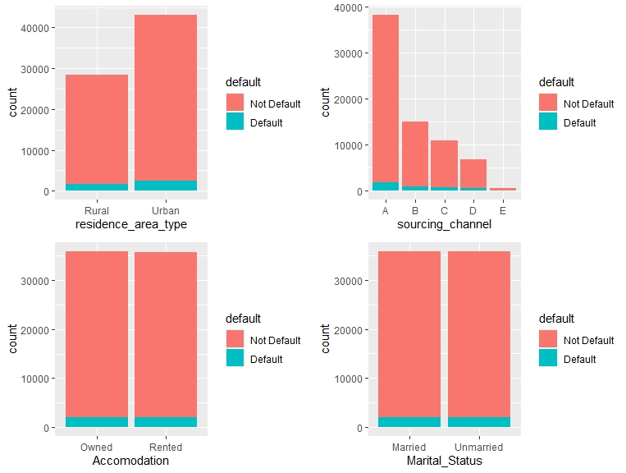
Bivariate Analysis
Default vs Categorical Variables

Slide 8
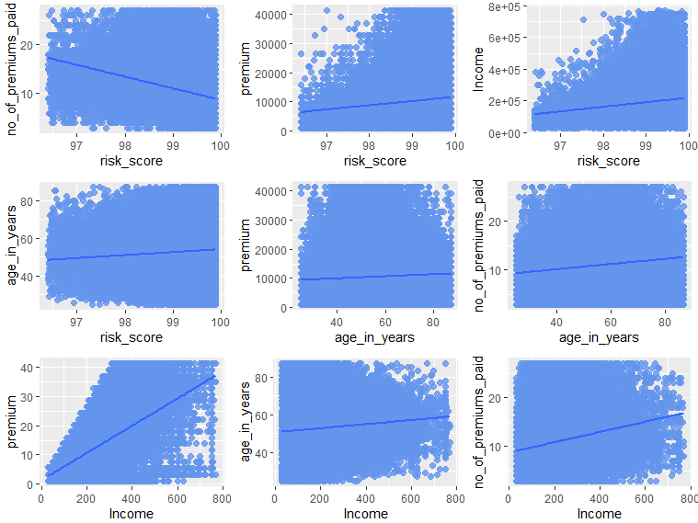
Bivariate Analysis
Correlation Analysis

Slide 9
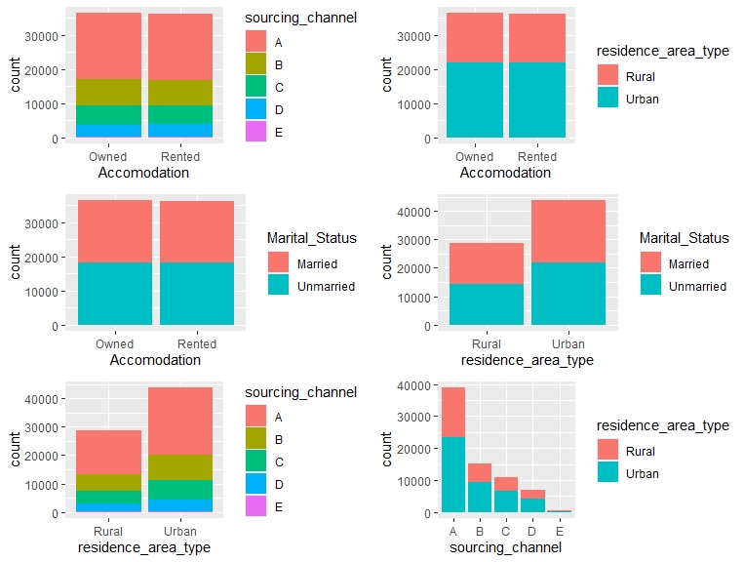
Bivariate Analysis
Correlation Analysis

Slide 10
Approach
What we Did to find Solution

Slide 11

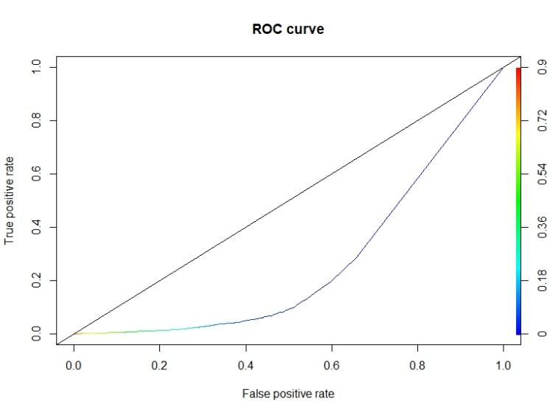
Random Forest
vs
Logistic Regression
We select this two technique because its common and applicable.
Data spilt for both technique as (70% train dataset – 30% test dataset)
We select the same features to train both models.
Features selected are:
Income - Count_3_6_months_late - Count_6_12_months_late
Count_more_than_12_months_late - risk_score - age_in_years
- perc_premium_paid_by_cash_credit

Slide 12
Difficulties
Regarding Data & Business

Slide 13
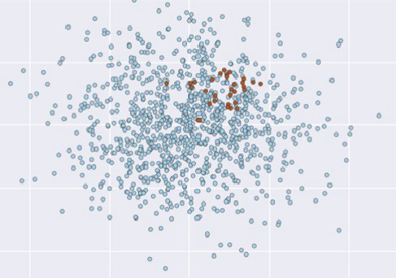
Balanced Data
vs
Unbalanced Data
We tried to do Synthetic Minority Oversampling Technique - SMOTE
We found that the models generated doing better without SMOTE
We decide to ignore SMOTE
We continue working with previous selected features

Slide 14
Solution
The best solution we found

Slide 15
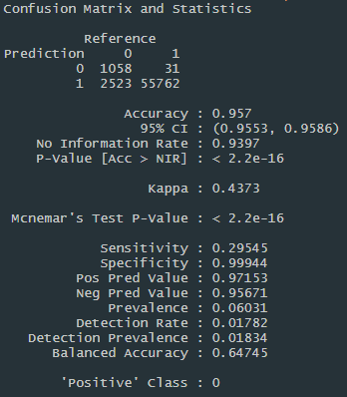
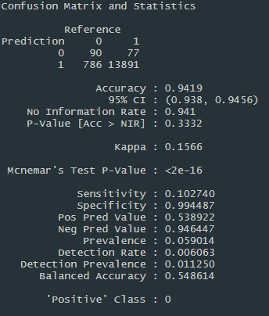
Random Forest
Confusion Matrix
Train Dataset
Test Dataset

Slide 16
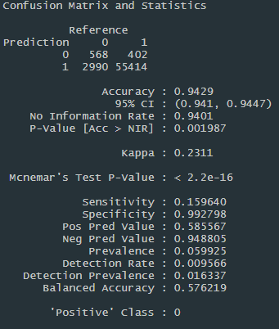
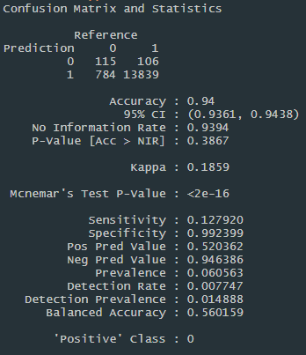
Logistic Regression
Confusion Matrix
Train Dataset
Test Dataset

Slide 17
Model Compression
Select the best..
Model | Accuracy on train data | Accuracy on test data | sensitivity on train data | sensitivity on test data | specificity on train data | specificity on test data
Random Forest | 95 | 94 | 29 | 10 | 99 | 99
Logistic Regression | 94 | 94 | 15 | 12 | 99 | 99
LR do better in term of Accuracy,
In term of sensitivity we noted that the value differences between test and train data is not big in LR technique
Both techniques do same in term of specificity
So. We are going to recommend the LR model to do the prediction.

Slide 18
Conclusion
Suggestion & Recommendations

Slide 19
While we see the importance of the historical insurance transaction and how it could help us to early identify the customers who has highest probability to default the premium, so that can help us to recognize the risk for each customer dependently, and then we can develop some categorical plan for them.
The only one issue here is that the ability to get real correct historical date, it should be scaled, cleared, and from trusted source.
If the potential customer are with risk to default the premium, we can innovate some new category with lowest price to aim his needs and save our money.

Slide 20
Thank you!

